Slide 1
Translating projections into a plan for housing growth
Grant Rainey
Senior Planning Officer
Gateshead Council

Slide 2
Introduction
Plan-making combines assessment of evidence with meeting local objectives / aspirations
When determining strategic needs for housing and economic growth, issues can be exacerbated by:
Changing evidence
Reforms to planning policy and guidance
Development of ‘best practice’ hindered by the complex issues affecting economic and housing market conditions at the local level
Notes:
Idea of discussing the application of projections data to planning came about during last year’s conference
Aim to discuss issues faced by LPAs when determining housing need figures within Local Plans
Using example of CSUCP
Issues in preparing and assessing evidence, translating this into policy. Tips from examination

Slide 3
Current guidance
NPPG
Planning Advisory Service technical advice note
LPEG recommendations revisions to NPPG/NPPF

Slide 4
Gateshead and Newcastle Core Strategy and Urban Core Plan
Joint strategic policies between Gateshead and Newcastle
Commenced 2009, adopted 2015
Examination summer/autumn 2014
Plans for 30,000 new homes and 22,000 additional jobs 2010-2030
Housing and economic needs didn’t delay examination process, and Inspector considered the plan was ‘sound’ without any changes to figures.

Slide 5
Changing policy context
Work commenced prior to revocation of RSS, publication of NPPF and Planning Practice Guidance
Key principles:
Robust and transparent to withstand scrutiny
Based on most up-to-date official data, where available, or justify deviation (compelling evidence)
Need to deliver objectives for sustainable growth
Local objectives
Positively prepared
Need to align population and jobs growth projections

Slide 6
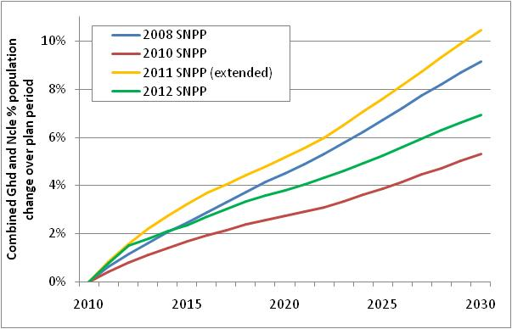
Changing evidence
Four sets of projections published during plan preparation, also 2011 Census data with revised MYEs

Slide 7
Changing evidence challenges
Aligning population change with jobs growth projections and objectives
Aligning quantitative needs for new housing (household growth) with availability of suitable land
Implications for Green Belt and other land use allocations / designations
Cross-boundary implications (potential request to accommodate, or provide for growth in neighbouring area (s)
Credibility of evidence, and of strategic plan-making

Slide 8
Economic growth
Household / population growth should be compatible with economic growth, when commuting assumptions are
For Gateshead and Newcastle, jobs growth of 22,000 additional jobs was compatible with projected growth in latest SNPP (2011-based interim projections)
Supported plan objectives of delivering sustainable growth in ‘heart’ of Tyne and Wear, and allowed Councils to defend against use of lower population/household projections
Use of ONS data (migration trends) also supported ability to demonstrate cross-boundary issues had been considered
Notes:
Gateshead and Newcastle obtained independent jobs growth projections
Inspector referred to Councils having taken a ‘hybrid’ approach of determining growth using population and economic projections, rather than having an economic, or demographic-led plan

Slide 9
Economic growth
While demographic change can be predicted with some (modest) confidence, projections of long term economic growth at local authority level are more volatile
Independent economic growth projections aligned with projected population change can give an Inspector confidence that a plan is sufficiently robust
Some evidence that plans aiming for higher levels of economic growth set out in some SEPs will be scrutinised more closely, especially where this does not correspond to past trends in population change
Notes:
3 ‘big’ economic forecasting agencies, however, can provide wide degree of variance in levels of economic growth
Comparing jobs growth projections against projections of change in supply of labour can provide a moderating effect to population / household change, while population change can also provide some context to jobs growth projections. PAS guidance highlights risk of ‘feedback loop’ when comparing jobs growth projections with projected change in labour supply.

Slide 10
Housing need
Population change + household formation rates = household growth
Household growth +/- change in dwelling vacancy = net housing requirement
Net housing requirement + replacement of demolitions and other losses = gross housing requirement
Notes:
LA areas with significant student population, and change in levels of dedicated student accommodation would need to consider this impact on housing need
Changes to dwelling vacancy can be considered. For Gateshead, around 1,000 households expect to be accommodated through bringing empty homes back into use. However, this shouldn’t be seen as an easy way to reduce housing requirement, as it will need to be considered in plan monitoring, of whether housing provision is meeting housing needs. If otargeted reduction in dwelling vacancy isn’t achieved, this could result in a need to accommodate more housing

Slide 11
Tips
Use assumptions that are supported by evidence / trends- realistic
Consider and address cross-boundary implications
Understand objectors’ arguments
Demonstrate that all relevant issues have been taken into account, including new evidence
Have a clear narrative (strategic objectives?), linked to evidence, and move quickly to submission
Expect to undertake new analysis during examination, but remain confident in the soundness of your plan
Notes:
Inspectors will likely ask for new evidence during examination, either to address new evidence, consider implications of change in NPPG, or to respond to objectors’ comments
Underpinning all of this is a need for planners to have confidence in their own assessment of evidence and translation of this into the Local Plan.
Planners should also recognise that there is no ‘magic number’ for a Local Plan – robust & up to date evidence should be assessed, using reasonable assumptions, to translate into the Plan

Slide 12
External factors
Specific conditions within / affecting your area
Mismatch between demographic change and economic projections, or objectives
Clear leadership
Cross-boundary issues
External intervention
Flux in the planning system, and economic uncertainty
Notes:
Could add to this list potential for ‘rogue’ inspector

Slide 13
Grant Rainey
grantrainey@gateshead.gov.uk
(0191) 433 3423

