Slide 1

'Opportunities and challenges of the 2011 Census'
Health Sector
Jake Abbas
Deputy Director
Yorkshire and Humber Public health Observatory
Yorkshire and Humber Quality Observatory

Slide 2
Contents
Background and context
Using the Census in the health sector
Some of our outputs
Live issues and challenges
Looking ahead
Contents

Slide 3
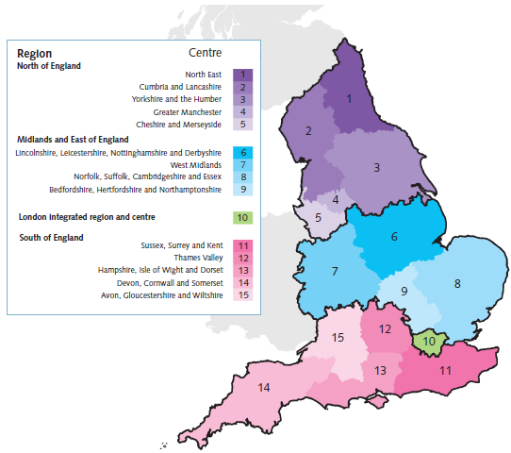
Public Health England structure – from April 2013

Slide 4
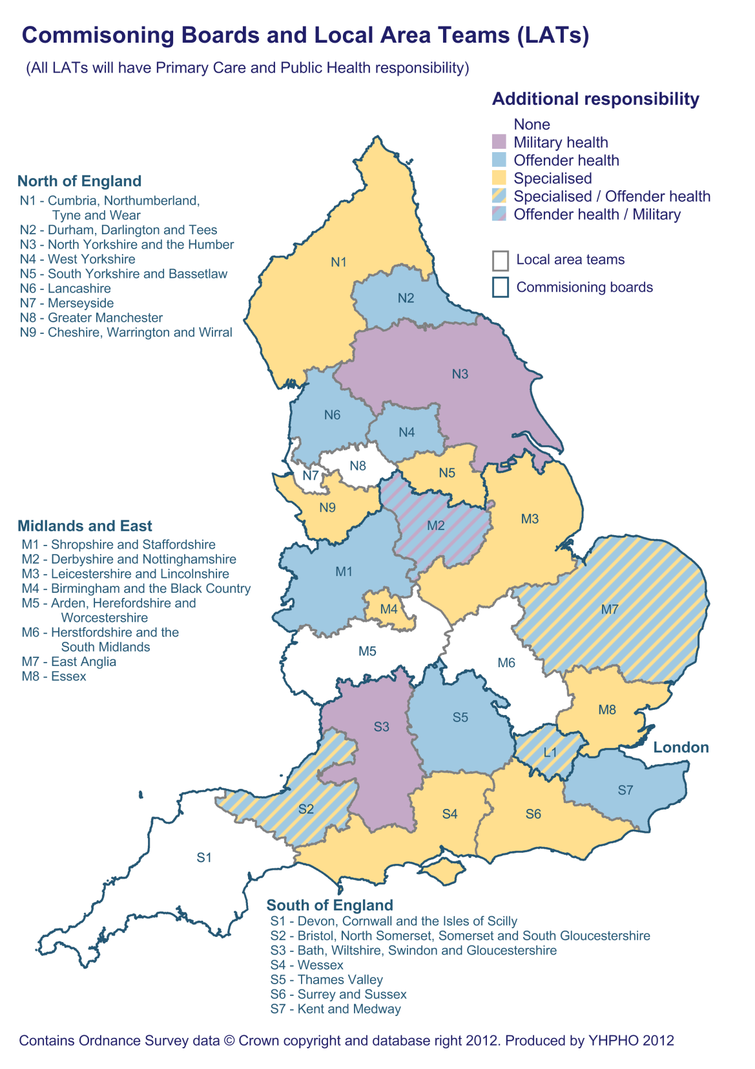
NHS Commissioning Board Structure

Slide 5
Health Intelligence functions from April 2013
(public sector only)
Local Authorities (incl. PH)
Clinical Commissioning Groups (CCGs)
NHS Providers
Commissioning Support Services
NHSCB – national, regional, local
PHE Evidence and intelligence teams (PHOs, HPA, Cancer registries, NTA, NDTMS, QARCs)
PHE National Office
NHSCB National office
PHE Region
NHSCB Regional office
PHE E&I Team
PHE Centre
NHSCB Local Area Team
LA
CCG
CSS

Slide 6
Using the Census in the health sector - JSNA
Profiling and mapping local populations
Population counts – e.g. populations of interest – older people, young children etc., rates such as all deaths per 100,000 population
Population changes and future needs
Wider determinants of health
Health specific questions
Ethnic groups (including gypsy and traveller pops)
Language (supporting health service engagement work at local level)
Carers

Slide 7
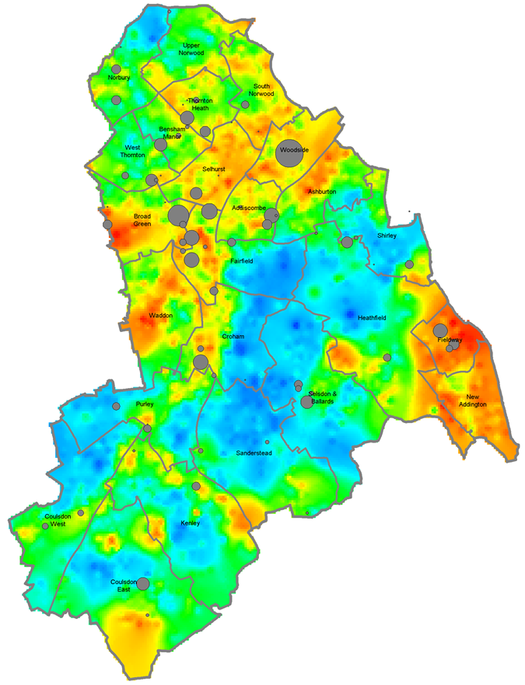
Using the Census in the health sector - Disease prevalence modelling, synthetic estimation, risk stratification
  Synthetic estimates – e.g. smoking, binge drinking, obesity, consumption of 5+ portions per day of fruit and vegetables
  Disease prevalence modelling
      Using prevalence estimates from Surveys e.g. Health Survey for England, research, primary care data
      Plus – population data, age, gender, deprivation, ethnicity etc
      Modelling current prevalence and future trends (e.g .POPPI)
  Risk stratification tools – mainly GP list but can be population based too

Slide 8
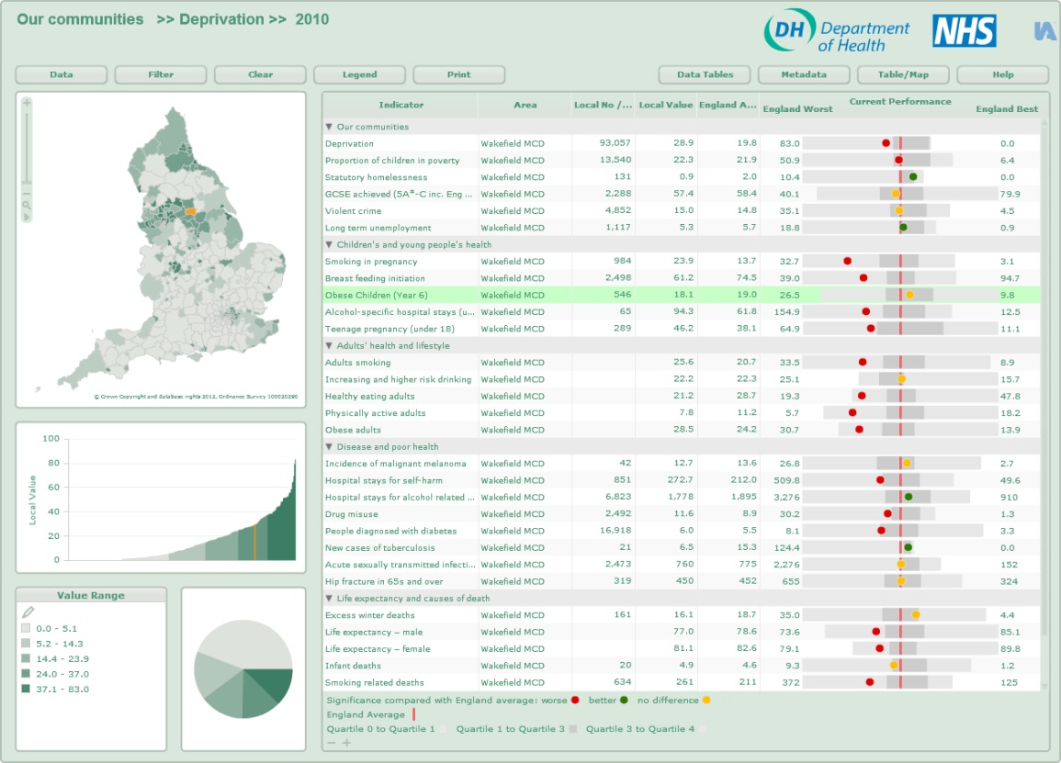
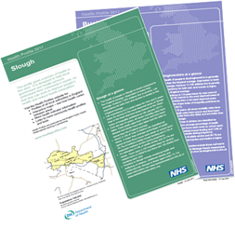
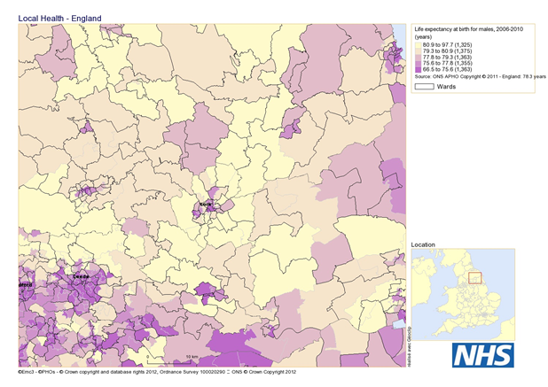
Examples of products….Health Profiles, Local health

Slide 9
Health specific questions in the Census
How is your health in general?’
‘Are your day-to-day activities limited because of a health problem or disability which has lasted, or is expected to last, at least 12 months?’
Self-reported health status – healthy life expectancy (Public Health Outcomes Framework)
Limiting long-term illness – disability-free life expectancy

Slide 10
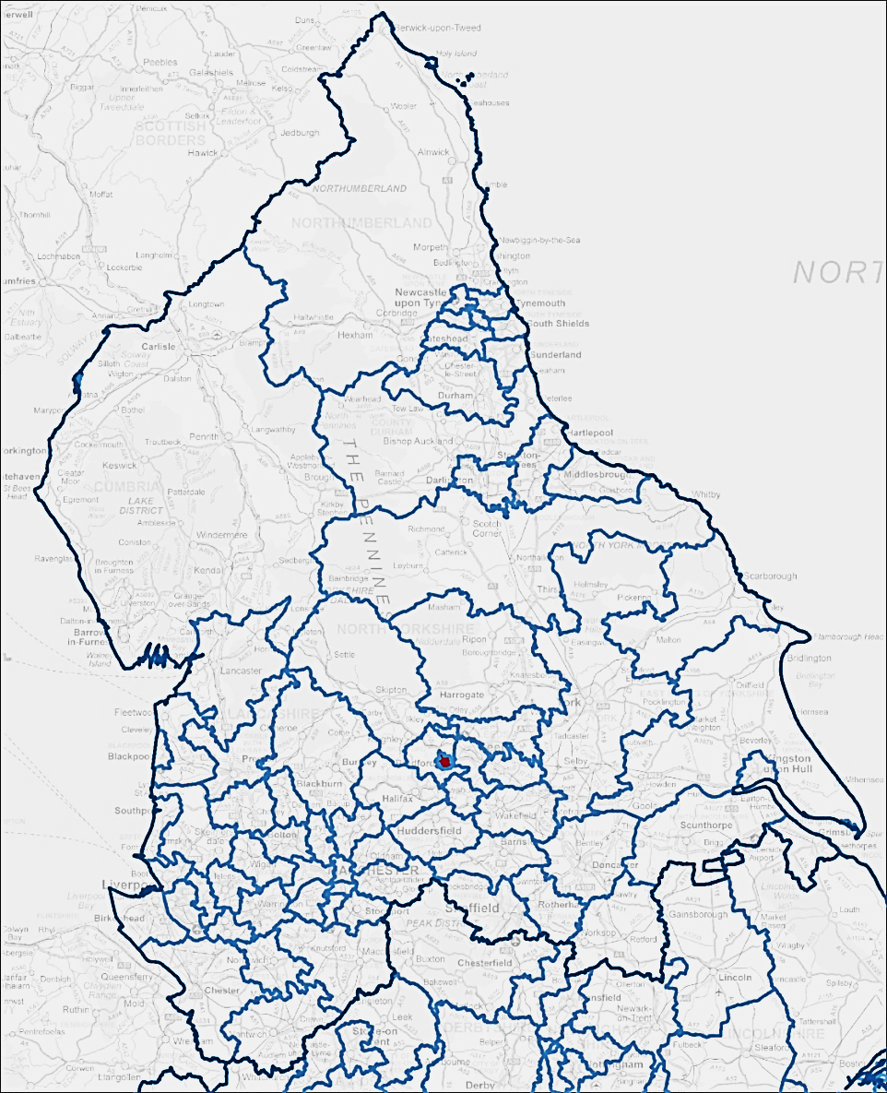
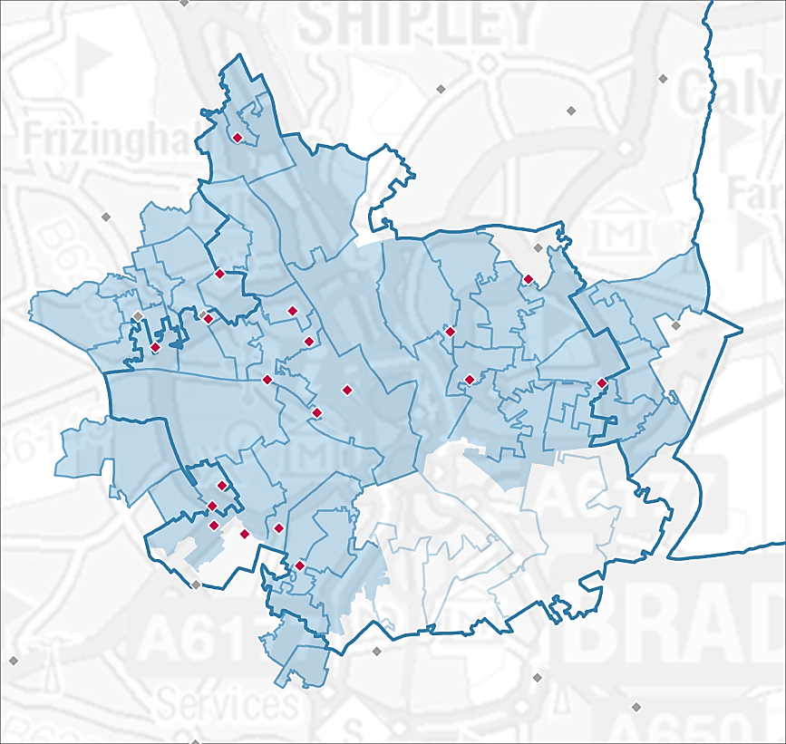
Live issues…Mapping CCG boundaries – registered and resident populations
Clinical Commissioning Groups (CCGs)
Northern England, CCGs
Bradford City CCG
Estimated CCG based on practice dominant in any LSOA
Current LSOA based CCG boundary from the Commissioning board website
Practices
Practices allotted to this CCG

Slide 11
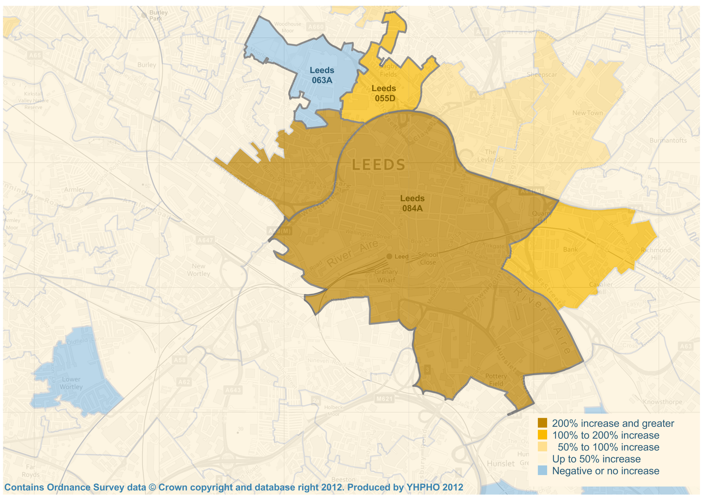
Live issues…Why LSOA boundary changes are important

Slide 12
Live issues…Implications of boundary changes
Definitions of CCG boundaries
Small-area datasets may be affected, especially time- series data
Any calculations that rely on LSOA data will be affected, which include the index of deprivation. This will have a knock-on effect for calculation of indicators that use the index of deprivation such as the slope indices of deprivation.

Slide 13
Looking ahead
National products through PHE
Other local partners – e.g. provider Trusts

Slide 14
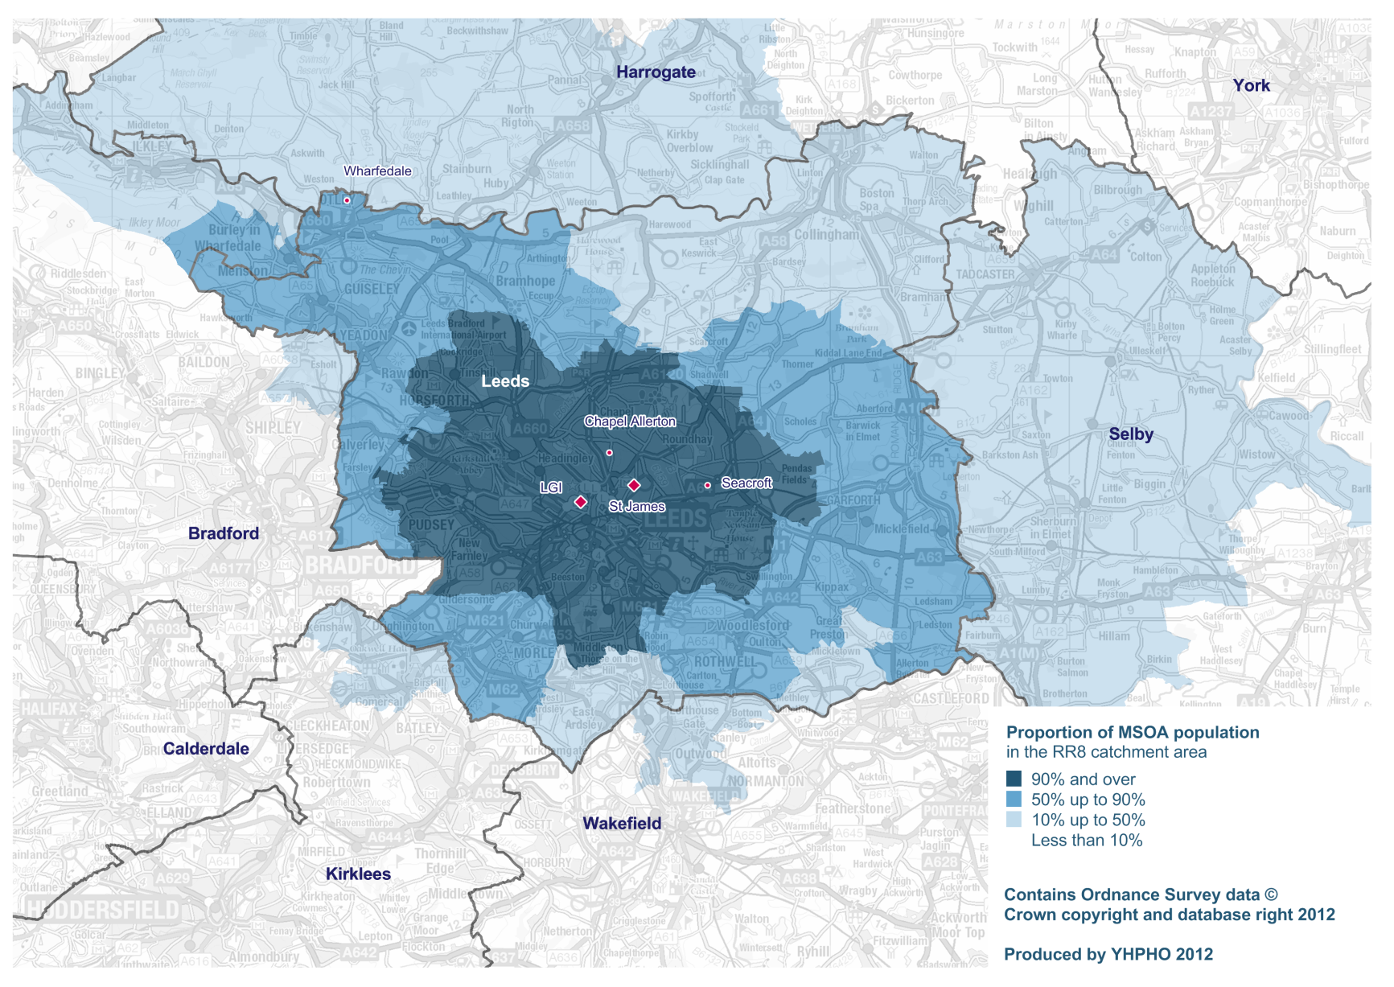
Looking ahead – profiling acute trust catchments

Slide 15
Looking ahead
National products through PHE
Other local partners – e.g. provider Trusts
Opportunities for more joined up local intelligence and analysis support?

Slide 16
'Opportunities and challenges of the 2011 Census'
Health Sector
Jake Abbas
Deputy Director
Yorkshire and Humber Public health Observatory
Yorkshire and Humber Quality Observatory

