Slide 1
Migration patterns and assumptions:
The challenge of looking into the future
Tony Champion Emeritus Professor of Population Geography, Newcastle University,
and President of the British Society for Population Studies Paper presented at TWRI Policy & Research Conference on ‘Population and Household Projections: Do we need them?’, York, 21 November 2014

Slide 2
Introduction
At last year’s TWRI national conference, I examined ‘changing patterns of migration’ and ended by looking forward to ONS’s 2012-based Sub National Population Projections (SNPP)
Now that these are available, my aim is to look behind the headline results and examine the migration assumptions, so as to assess how much confidence can be placed in them for policy and planning purposes
The 2012-based SNPP have a big advantage over the previous rounds in being based on a starting population that has been revised in the light of the 2011 Census results
But the projections for 2012-2037 are only as reliable as the assumptions on which they are based – for much of migration, this is the average of the latest five years of recorded rates
How useful is 2007-2012 as a guide for 2012-2037?

Slide 3
International migration
Driven by the National Population Projections for UK and its four countries (published Nov 2013), before the results are distributed across sub-national geographies by their agencies
NPP assumptions are based on average of latest 6 years of records (cf the 5 of the internal migration assumptions) and involve actual numbers (not rates)
These average numbers are used for the main part of the 25-year series, but may be adjusted for the first few years if deemed advisable by ONS and its expert panel
Result is a long-term projection of 165k net gain, with short-term series adjusted only for scheduled return of armed forces from Germany over 6 years (giving totals of 165k, 166k, 165k, 184k, 171k & 174k for 2012/13 to 2017/18)
Variant projections allow a high/low range of ca 60k around the principal projection, i.e. ca 105k-225k for long-term series

Slide 4
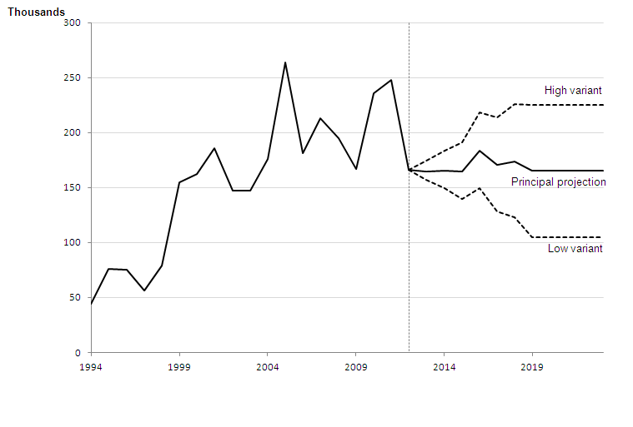
Estimated and assumed total net migration for UK, for year ending mid-1994 to year ending mid-2023
Source: ONS (2013) 2012-based National Population
Projections: 5. Migration assumptions, Figure 5-4

Slide 5
International migration: an assessment
Anticipating international migration trends is hugely complex, with miriad factors affecting the UK’s migration exchanges with 200+ other countries
Also, not helped by large confidence intervals in migration records based on International Passenger Survey (IPS), with large fluctuations in annual estimates
Both are allowed for in the variant projections range of 60k, which give a 2037 population of 75.0m (high) and 71.6m (low) around central projection of 73.3m
The 2012-based long-term assumption of 165k is lower than the 200k of the 2010-based set, ‘due to taking account of final migration data for 2010 and 2011’
The actual figure for calendar year 2013 is put at 212k, but ‘this is not a statistically significant increase from 177k the previous year’ – even so, an indication of the uncertainties

Slide 6
Internal migration
Methodology for within-country migration varies somewhat between the 4 countries, but the basic approach is to use the latest 5 years of data (from MYE components of change)
In the English case, the out-migration flow from each LA/UA to each other one is put in ‘rate’ form by age and sex, then all the derived inflows are summed to give net flow for each
For the 2012-based set, ‘data from 2007/08 to 2011/12 are used to estimate the average proportion of the population that has left a particular LA and where they moved to’
Rates calculated from MYEs as revised after 2011 Census
The expert panel did discuss adjusting for the 2008-09 recession and its aftermath, but this has not been done: The projections ‘do not attempt to predict the impact that future … policies, changing economic circumstances or other factors may have on demographic behaviour’

Slide 7
Internal migration: an assessment
The key issue is how far the LA out-migration rates for 2007-12 will continue through the 25 years to 2037, though also relevant are the shares going to each of the other LAs
It is well-established that overall migration rates fluctuate across economic cycles, as also does the spatial patterning, especially due to the ‘pivotal role’ of London
London’s net migration balance with rest of UK has ranged from -20k in 1990/91 to -120k in 2003/04 and was again down below -40k in 2008/09

Slide 8
London’s net loss to rest of UK since 1975 broadly reflects economic cycles, especially boom to bust in mid 2000s
Source: calculated from NHSCR data for London as defined as GLA area

Slide 9
Internal migration: an assessment
The key issue is how far the LA out-migration rates for 2007-12 will continue through the 25 years to 2037, though also relevant are the shares going to each of the other LAs
It is well-established that overall migration rates fluctuate across economic cycles, as also does the spatial patterning, especially due to the ‘pivotal role’ of London
London’s net migration balance with rest of UK has ranged from -20k in 1990/91 to -120k in 2003/04 and was again down below -40k in 2008/09
One way of illustrating the wider picture is by comparing migration for 2007-12 with that for 2001-07, using data compiled for the 64 cities of the State of the English Cities

Slide 10
Net migration from England’s cities to towns and rural areas fell markedly after 2007, especially for London (PUA)
Source: calculated from ONS data for 64 cities
as defined in The State of the English Cities Report

Slide 11
Internal migration: an assessment
The key issue is how far the LA out-migration rates for 2007-12 will continue through the 25 years to 2037, though also relevant are the shares going to each of the other LAs
It is well-established that overall migration rates fluctuate across economic cycles, as also does the spatial patterning, especially due to the ‘pivotal role’ of London
London’s net migration balance with rest of UK has ranged from -20k in 1990/91 to -120k in 2003/04 and was again down below -40k in 2008/09
One way of illustrating the wider picture is by comparing migration for 2007-12 with that for 2001-07, using data compiled for the 64 cities of the State of the English Cities
The latest data on London’s migration balance with rest of UK suggests some effects of economic recovery, especially in terms of balance with Greater South East

Slide 12
GLA’s net loss to Greater South East has been growing again from 2009/10, with further ‘ripple effects’ now expected
Source: calculated from NHSCR data for London as defined as GLA area

Slide 13
This acceleration in London’s net exodus to rest of UK means less population increase there for 2012-2037 than in ONS’s projected regional population change shown below
Source: 2012-based Sub National Population Projections for England (ONS, 2014)

Slide 14
If ‘ripple’ reaches North East, this would offset its 47k cut in within-England migration made by the 2012-based projection

Slide 15
Discussion 1
If history repeats itself, then the further progress of economic recovery will lead to an acceleration in internal migration rates and especially in urban-to-rural migration – in which case, a longer base period than 2007-12 would have been preferable (or, at least, a variant projection)
BUT maybe …

Slide 16
Discussion 2
BUT maybe history will not repeat itself because of some more fundamental change(s) in economy and society, e.g.:
The recovery from the ‘Great Recession’ is slower than that from previous recessions, so is it qualitatively different too?
Household formation rates and ability to access owner occupation have fallen in recent years, so where to now?
Will a longer-term tendency for people to move home less often continue into the future?
There has been marked urban resurgence since the 1980s, but how robust this will prove, especially beyond London?
Will the rising ethnic minority presence in the population (especially of larger cities) reduce the urban exodus?
Given that London is ‘pivot’ of whole UK migration system, what happens if net immigration falls to ‘tens of thousands’?
Some evidence behind these questions …

Slide 17
There has been a fall in rates of 10-year address changing, but nearly all this is due to a reduction in moves of <10km
Source: Calculated from ONS Longitudinal Study. Crown copyright.

Slide 18
Much faster population growth since 2001 in all 3 size groups of cities in both halves of England, with London leading
Source: calculated from ONS data for 64 cities
as defined in The State of the English Cities Report

Slide 19
London’s gains from overseas are largely offset by its losses to rest of UK, but is there a causal link between the two?
Source: calculated for 2001-2012 from ONS data for 64 cities
as defined in The State of the English Cities Report

Slide 20
Final word
Lots to ponder…any answers to these sorts of questions?
Makes one feel that the ONS is right in sticking to trend projections rather than trying to forecast!
But that does not lessen the challenge for those responsible for forward policy and planning
Would it help if ONS (or someone else) were to produce variant projections for LAs etc (as is currently done for Scotland and Wales)?
Could users cope with the explicit uncertainty which arises from variant projections (especially if no precise confidence ranges)
All this makes me wonder how useful sub-national projections of population and households really are …

Slide 21
So I am looking forward to Ludi’s take on this question later,
as well as your reactions!
Tony Champion
tony.champion@ncl.ac.uk

