Slide 1
Labour force projections for Districts of Britain
Ludi Simpson, University of Manchester
TWRI conference, York 9th October 2015

Slide 2
Local planning context -1
Requires forecast by age and sex of local population (ONS etc), headship rates (DCLG etc), and economic activity rates (no-one)
Their inter-relationship is what local planners and demographers attempt to model and forecast.
  migration-led forecasts
    Future population age-sex structure->housing, jobs
  dwelling-led forecasts
    Future housing land -> population age-sex -> labour force
  jobs-led forecasts
    Future jobs -> population age-sex -> households, housing land

Slide 3
Local planning context - 2
The Cameron governments’ Planning Guidance has encouraged jobs aspirations in local plans
  Jobs attract migration which implies extra housing land
    Unless economic activity increases
  This application is perhaps the largest practical motivation for forecasts of local authority economic activity
Local jobs aspiration as part of national policy has contradictory implications:
  If all local plans fulfilled aspirational plans there would be more jobs everywhere
    Economic activity would have to increase
    There would be no impact on housing land

Slide 4
Past economic activity rates, broad age groups
UK, Labour Force Survey

Slide 5
The 10 day challenge
POPGROUP software (Derived Forecasts) provides a structure to implement by age & sex the identity: Labour Force = Population * Economic Activity rate
How to forecast future economic activity rates for all LADs? Options:
  Relate the recent local level to a national projection?
  Or model locally? Test with 1991-2001-2011
  Which national projection? EU or OBR?
  Which local level? Census 2011 or LFS?
User’s subsequent question
  When building on a standard economic activity projection: which local scenarios are sensible?

Slide 6
Outline
Methods for labour force forecasts
Current forecasts for the UK or smaller areas
  Cambridge Econometrics, Oxford Economics, local plan documents
  OBR, EU, ILO for the UK
Data available for local areas
  Census 1991-2001-2011
  Test of options: what is stable about local economic activity?
  Annual Population Survey/LFS
Tasks seeking researchers
Proposed strategy, under consultation

Slide 7
4 trends observed throughout the EU
“The participation rates of prime-age male workers (aged 25 to 54), at around 90%, remain the highest of all groups.
The participation rates of men aged 55 to 64 years, which had recorded a steady decline in the past twenty five years, are showing clear signs of a reversal in most countries since the turn of the century, mostly due to pension reforms raising the statutory retirement age or the state pension age;
Female participation rates have steadily increased over the past twenty five years, largely reflecting societal trends;
The participation rates of young people (aged 15 to 24 years) have declined, mostly due to a longer stay in school;”
European Commission (2014) The 2015 ageing report - Underlying Assumptions and Projection Methodologies, European Economy 8/2014, p30

Slide 8
Economic activity rates, age and sex
1971-2011 Censuses, England & Wales
1. High ‘prime age’ participation
2. Reduced older male participation, recently recovered
3. Rising female participation
4. Reduced young participation
Males
Females

Slide 9
Methods
ILO (2011) and OECD (2003) European Commission (2005) among other reviews , identify four strategies:
Judgemental, qualitative – where few data exist and no time series of activity rates. ECB, most local plan scenarios
Time extrapolation of activity rates, including s-curves – where time series exist. Use of s-curves implements an assumption that past change will reduce. Most common. ONS; ILO; USA(BLS)
Regression models based on correlations with economic, cultural, demographic factors. Unusual outside academia. Religion?
Cohort approach based on [net] entry and exit ‘rates’ from the labour force at each age, males and females separately. OECD; EC; OBR
  When inactivity decreasing, ‘Entry rate’ =
  1 – (Inactivity rate age a+1 time t+1 / Inactivity rate age a time t)
    Eg a tenth of 25 year old inactive males become active.
    A ‘death rate’ applied to those inactive at time t, the result added to activity age a at time t
  When activity is decreasing, ‘Exit rate’ =
  (Activity rate a+1 time t+1 / Activity rate age a time)
    A growth rate applied to those active at time t.

Slide 10
Previous LAD projections
Cambridge Econometrics age-sex- economic activity for LADs, used by Warwick IER’s Working Futures
  No documentation
Oxford Economics all-age economic activity as a product of a model of employment
  East of England, E. Midlands, Greater Manchester, ...
  Unspecific documentation
Local authority and planning agency submissions
  Great variety of approaches in reports
  Plausible scenarios of future change (judgemental approach)
  Impact of State Pension Age rise of X years modelled by shifting activity to that of a younger group by X years (Shropshire and others).

Slide 11
Labour Force forecasts for the UK
Age | EC(2014) 2015 Ageing report | OBR (2015) Fiscal Sustainability Report
16-24 | Constant at 2013 values | Reduced participation rates, accelerated entry rates age 20-24 to compensate. Judgemental.
25-54 | Constant entry and exit rates, based on LFS2003-2013 | Constant entry and exit rates, based on LFS1997-2008.
55-74 | Shift upwards to reflect pension changes, using average retirement age and judgement. | Reduce female exit rates near retirement age to equalise with male. Shift exit rates 1 year to reflect rise in SPA 1 year, starting 10 years earlier. Not well specified.
75+ | Zero activity | Not specified
Doc | Incomplete methodology | Brief and incomplete methodology.
Data | Available on request for research | 16+ only, to 2020 only. Slightly more in editions from earlier years.
Only the European Commission projection is available

Slide 12
EC past and projected economic activity, selected age groups
Is the European Commission projection too flat for young and elderly?
Can it be improved? Is the OBR better, or just different?

Slide 13
Local authority districts: data in Britain for economic activity
APS/LFS – annual up to March 2015
  Sample small for LAD by age and sex
  Households plus student halls – not other institutions
Census 1991, 2001, 2011
  16-19, five-year age groups to 60-64, m/f
  Other age groups differ between years and countries
    2011: England 65+, Sc & NI 65-74, 75+
  Data can be made consistent for 2011 geography
    Except Scotland 1991

Slide 14
Tests with 348 England & Wales Local Authority Districts 1991-01-11
What is stable about local economic activity?

Slide 15
LAD’s distance from the average remains similar over time
- Students, ex-industrial areas, muslim women
Changes over one decade tended to not to be continued in the next decade
There has not been convergence over time
Correlation Correlation Variation (SD)
348 LADs E&W economic activity
One census with next
Change 91-01 with change 01-11
 | 91-01 | 01-11
M1619 | 0.63 | 0.90 |  | -0.07
M2024 | 0.69 | 0.97 |  | 0.04
M2529 | 0.82 | 0.86 |  | -0.34
M3034 | 0.85 | 0.85 |  | -0.43
M3539 | 0.91 | 0.89 |  | -0.50
M4044 | 0.91 | 0.94 |  | -0.59
M4549 | 0.93 | 0.95 |  | -0.58
M5054 | 0.93 | 0.94 |  | -0.15
M5559 | 0.90 | 0.94 |  | -0.03
M6064 | 0.93 | 0.96 |  | -0.01
F1619 | 0.60 | 0.90 |  | -0.09
F2024 | 0.71 | 0.93 |  | -0.14
F2529 | 0.77 | 0.85 |  | -0.02
F3034 | 0.76 | 0.80 |  | 0.05
F3539 | 0.85 | 0.85 |  | -0.02
F4044 | 0.84 | 0.91 |  | -0.07
F4549 | 0.80 | 0.91 |  | -0.26
F5054 | 0.85 | 0.89 |  | 0.08
F5559 | 0.84 | 0.89 |  | 0.15
F6064 | 0.89 | 0.94 |  | -0.31
‘91 | ‘01 | ‘11
8.0 | 6.0 | 8.1
10.0 | 4.3 | 10.6
3.4 | 2.0 | 3.2
3.2 | 1.8 | 2.6
3.4 | 2.0 | 2.8
3.9 | 2.4 | 3.2
4.7 | 3.2 | 3.5
5.6 | 5.0 | 4.1
7.7 | 7.9 | 5.0
9.3 | 9.6 | 6.4
8.0 | 5.2 | 8.0
8.9 | 4.2 | 8.4
5.1 | 4.6 | 4.2
4.0 | 3.7 | 4.1
4.0 | 3.7 | 3.9
4.7 | 3.9 | 4.0
5.2 | 4.1 | 3.9
5.7 | 5.1 | 4.5
6.4 | 6.2 | 5.1
5.2 | 5.2 | 5.5

Slide 16
Tests with E&W districts 1991-01-11
How well do different strategies estimate 2011 local economic activity, using 1991-2001 data?
  2001 no change
  2001 plus national change (actual 01-11, or repeat 91-01)
  2001 plus local change (repeat 91-01, or cohort)
  For each strategy:
  ‘change’ applied as % points (additive) or as proportion (multiplicative)
  Rates not allowed to go beyond 0% or 100%
  Accuracy: absolute % point difference with 2011 census

Slide 18
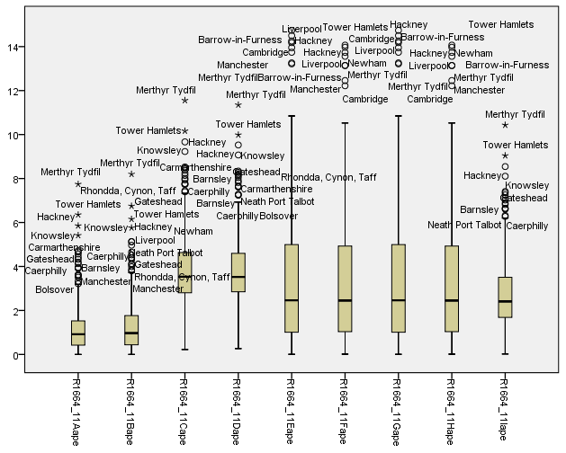
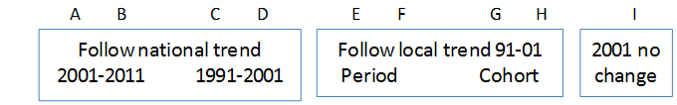
Absolute error for persons 16-64
2011 economic activity rates, 348 LADs of E&W. E&W mean: 77.9%

Slide 19
Females
Males

Slide 20
Summary of testing
Suggested by these tests:
  Use a recent local profile, project forward by adding the change in a good national projection
Other results of testing:
  Combining strategies did not improve them
  Student areas were poorly projected when proportions were changing
  Disaggregation to age-sex groups did not improve the estimate of the total 16-64 % economically active

Slide 21
Does the APS provide a better starting point than the 2011 Census?
Age 16+
Females aged 50-64
Males aged 16-19
Manchester: economic activity year ending March, 2005-2015, with 95% CI
2011 Census

Slide 22
APS of interest in fast-changing areas, but not of benefit to standard projections
Cheshire East: economic activity year ending March, 2005-2015, with 95% CI
Age 16+
Females aged 50-64
Males aged 16-19

Slide 23
Tasks seeking researchers
Serious national forecast
  5-year age-sex cohort history for UK
  Time series analysis of period and cohort rates
  Separate student population and its activity
  Quality assured and documented to National Statistics standards
Local scenarios: review of data, methods, performance, and promotion of best practice
  Measure uncertainty, post-hoc distribution of errors, and probabilistic derived projections
  Which characteristics of LAs might identify groups which can be best projected together?
    Regions, socio-economic types, religious composition
Refinement of a first standard LAD projection

Slide 24
Conclusions, consultation
Conclusions
  Use the 2011 census LAD age-sex economic activity
    Commission table for 5-year age-sex groups to 70-74 and 75+
  Project forward by adding the change in a series of scenarios based on UK data
    Scenarios, not the best UK projection
    Alternative Default sheets in POPGROUP’s Derived Forecasts
  Start with 2001, simple linear interpolation to 2011

Slide 25
Consultation
Scenarios
  Constant based on the latest local value
  The OBR projection if released – can it be reconstructed?
  The EC projection
  Extrapolate 16-24 recent change: is there evidence of how it will develop?
  Extrapolate 55+ recent change. (a) logistic regression, (b) adding the extra impact of a rise in SPA of one year by shifting EA rates one year
  Move women’s rates to equal those of men, or to be as closely equal as has been achieved by the most equal European country
  All rates by a specified annual increment: in effect altering the total economic activity
Other queries
  APS/LFS, can it be used in a standard way locally?
  Are there other standard local adjustments to the projection?

