Slide 1

Anne Green Institute for Employment Research, University of Warwick Anne.Green@warwick.ac.uk Conference on Labour Market Perspectives: Challenges, Statistics and Future Possibilities, York 9th October 2015
Linking people in poverty to jobs: the role of growth sectors

Slide 2
Context
Growth of in-work poverty
Concerns about job quality, fragmentation of working hours, non-standard employment
Changing national Government approach towards welfare and employment policy
Selected devolution to cities – greater responsibility for delivering improved labour market outcomes
Government concerns with rebalancing the economy – sectorally (renewed interest in industrial strategy) and spatially

Slide 3
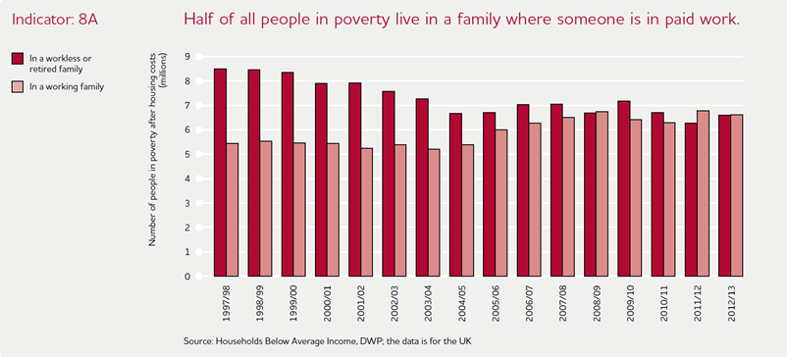
Changing nature of poverty
Growth of in-work poverty
Concerns about job quality, fragmentation of working hours, non-standard employment, low hours / zero hours contracts

Slide 4
The labour market in recession and beyond
The value of real wages fell by 10 percent between 2008-2014 – relatively uniform across the wage distribution (but higher for young people) (Machin, 2015)
Increase in (hours) underemployment – just under 3 million workers want additional hours, underemployment rate now around 10 per cent (7 per cent pre-recession) (ONS, 2014)
Growth of zero hours contracts – 2.4 per cent of people in employment (ONS, 2015)
Longer-term concerns about the ‘long-tail’ of low-paid/low-skilled work in the UK (Finegold and Soskice, 1988; Wilson, Hogarth et al., 2003; Wright and Sissons, 2012)

Slide 5
Policy for employment and poverty
Shift away from redistribution (2010-2015; 2015-2020):
“from a low-wage, high-tax, high-welfare economy to the higher wage, lower tax, lower welfare country” (Osborne, 2015)
Large cuts in welfare spending (for working-age benefits)
Raising the income tax personal allowance
Introducing a ‘Living Wage’ of £7.20 April 2016; £9 by 2020
Progress on poverty becoming more dependent on employment trends

Slide 6
Rebalancing: growth sectors
Background
Focus
UK governmental concerns with rebalancing the economy:
sectorally - services to manufacturing - public to private
spatially - London/GSE to rest of UK
Renewed interest in industrial strategy and (limited) devolution
Sectoral dimension of rebalancing
Rationale for targeting sectors for growth - two perspectives: - economic competitiveness - social inclusion
How are growth sectors defined?
How to they map onto labour market change in the UK?
What are barriers and opportunities for harnessing growth sectors for competitiveness and inclusion?

Slide 7
Targeting ‘growth sectors’ for competitiveness: 1
NATIONAL - Industrial Strategy: focus on sectors of long-term strategic importance to offer more tailored support and deliver ‘horizontal’ policies more effectively
Advanced manufacturing (e.g. automotive) - sectors of technological strength with key drivers for ‘high value’ products
Knowledge intensive traded services (e.g. professional and business services) – sectors of UK comparative advantage with strong growth in technology and links to other parts of the economy
Enabling industries (e.g. energy, construction) – have a major impact on other sectors, regulation is a strong influence
Industrial Partnerships: bring together employers, trade unions, professional bodies and SSCs on a sectoral basis to lead the development of skills, with a focus on growth and competitiveness

Slide 8
Targeting ‘growth sectors’ for competitiveness: 2
Industrial Strategy
Industrial Partnerships
Aerospace
Agricultural technologies
Automotive
Construction
Information economy
International education
Life sciences
Nuclear
Offshore wind
Oil and gas
Professional & business services
Aerospace
Automotive
Creative industries
Digital
Energy and efficiency
Nuclear
Science
Tunnelling

Slide 9
Targeting ‘growth sectors’ for competitiveness: 3
LOCAL / CITY-REGIONAL
Local Enterprise Partnership (LEP) Strategic Economic Plans: identify ‘growth sectors’ / ‘priority sectors’ / ‘core sectors’ / ‘key sectors’: - “key to future economic growth” - “offer genuine strength and economic opportunity”
Emphasis locally on ‘high value’ sectors as in the Industrial Strategy:
Advanced manufacturing
Digital and creative
(Green / Efficient) Energy
City Deals and Local Growth Deals are part of a gradual (and uneven) transfer of powers towards more localised control of employment and skills policy – local policies often focus on ‘priority’ sectors

Slide 10
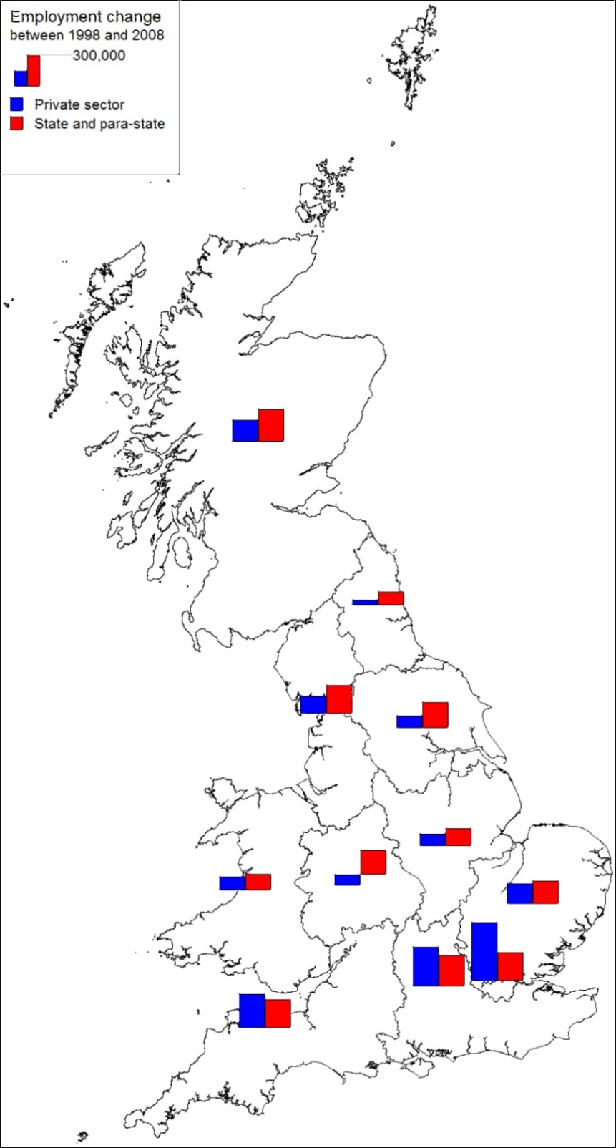

Spatial variations
Most geographically concentrated industries – exemplars
Manufacture of motor vehicles
Manufacture of air and spacecraft
Manufacture of parts and accessories for motor vehicles
Least geographically concentrated industries – exemplars
Retail sale in non-specialised stores
Restaurants & mobile food services
Residential nursing care activities

Slide 11
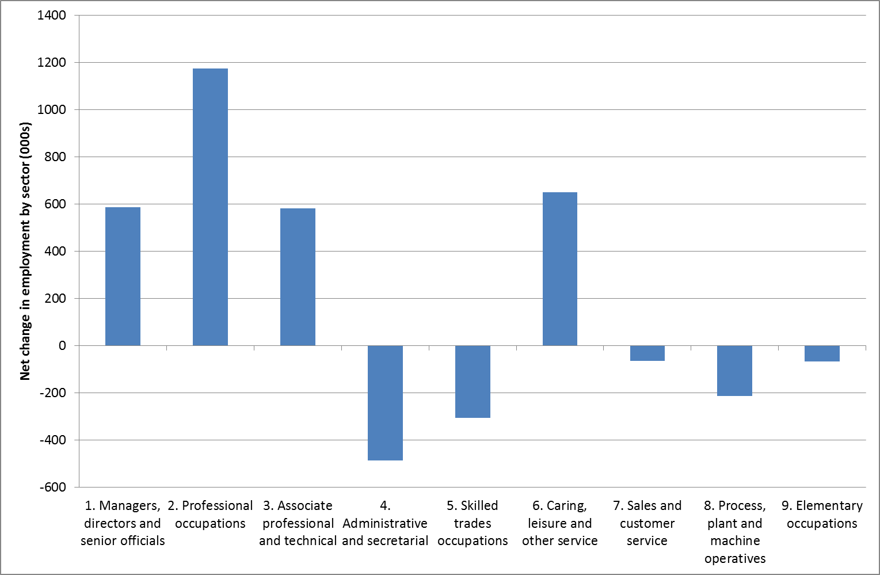
Projected employment change: by Occupation, 2012-2022

Slide 12
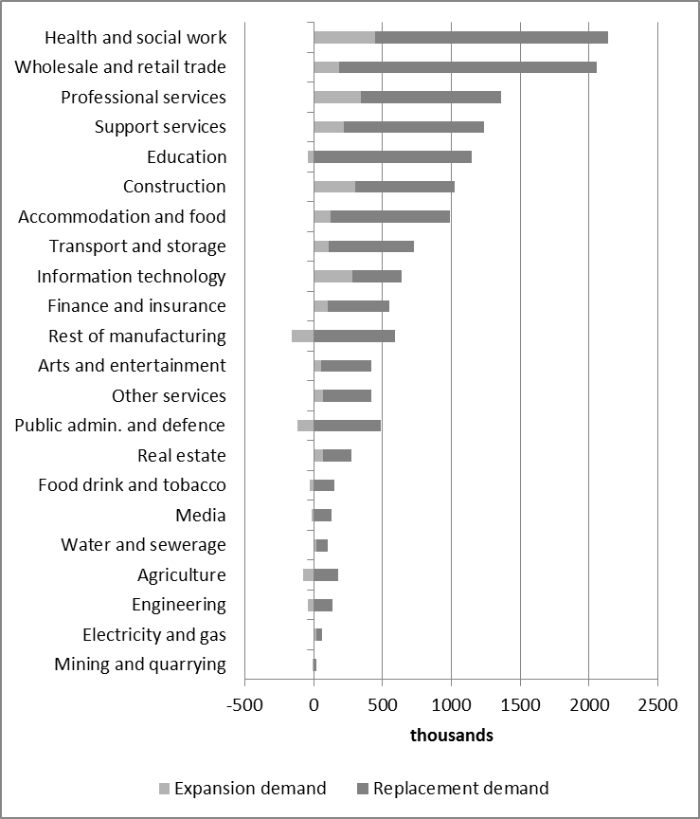
Expansion and replacement demand by sector, 2012-2022
Ranked by overall net requirement – Health & social work and Wholesale & retail largest net requirement
Replacement demand outstrips expansion demand

Slide 13
‘Growth sectors’ for inclusion: 1
Limited overlap between growth sectors for competitiveness and growth sectors for inclusion
Focus tends to be on a narrow range of ‘fashionable’ growth sectors (Peck et al., 2013; Sissons and Jones, 2013) – less interest in issues concerning low-paid sectors
Mirrors national policy in ‘ignoring the bulk of current productive capacity (Mayhew and Keep, 2014: 6)
Several low-paid sectors have high projected net employment requirements

Slide 14
‘Growth sectors’ for inclusion: 2
Emphasis on inclusion requires an emphasis on ‘high employment’ growth sectors – nationally and locally
relevance of replacement demand as well as expansion demand
‘high employment’ sectors tend to be characterised by a relatively even spatial distribution
Can tailor policy initiatives to demands of specific sectors and to address specific ‘business case’ issues (e.g. shortage of recruits, skills gaps, etc.)
Ideally need sectors with low-skill roles (for those entering work) – may be high churn sectors – and with intermediate and high-skill roles for progression

Slide 15
Targeting ‘growth sectors’ for inclusion: 3
Health and social work

Slide 16
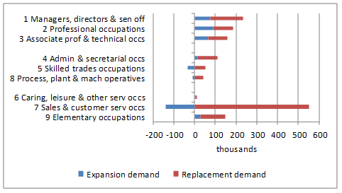
Targeting ‘growth sectors’ for inclusion: 4
Retail

Slide 17
Targeting ‘growth sectors’ for inclusion: 5
Accommodation & food services

Slide 18
Local level: Emerging devolution of powers to cities
City Deals and Local Growth Deals are part of a gradual (and uneven) transfer of powers towards more localised control of some areas of economic development and skills policy (O’Brien and Pike, 2015)
Some opportunities for LEPs developing policy focused on low-paid workers – e.g. European Structural and Investment Funds programme (ESIF), including on in-work claimants
Cities therefore assuming increasing responsibility for delivering improved labour market outcomes

Slide 19

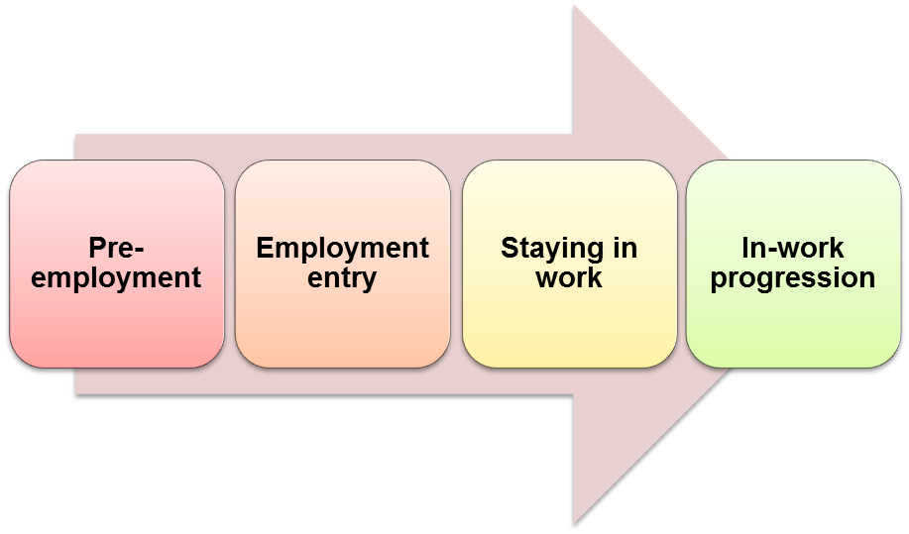
Linking people in poverty with jobs
Employment Pathway

Slide 20
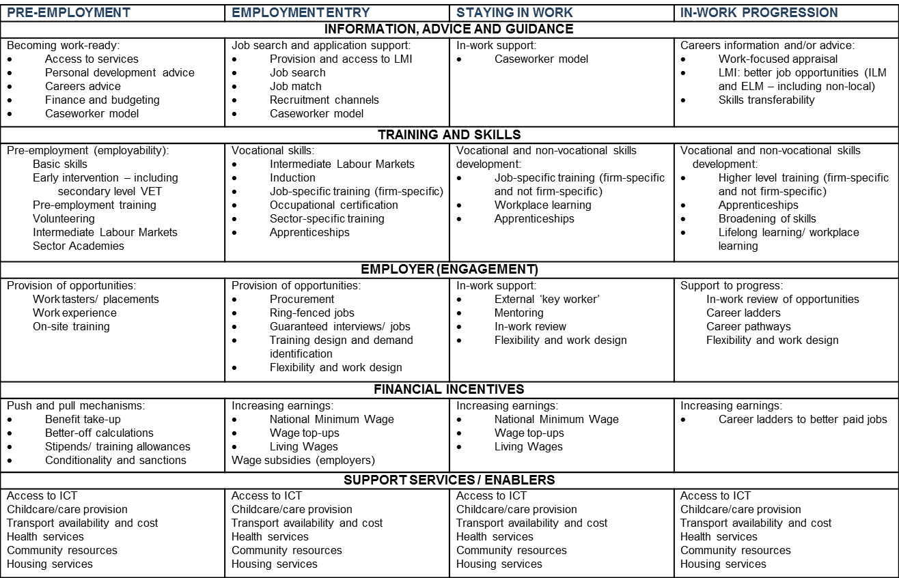

Slide 21
Addressing local opportunities and policy levers
Strategy and delivery of services – e.g. IAG, skills, LMI
The ‘business case’ - can tailor policy initiatives to demands of specific sectors locally and to addressing specific ‘business case’ issues (e.g. shortage of recruits, skills gaps, etc.)
Utilising new developments – e.g. growing apprenticeships
Public sector ‘leading by doing’ – e.g. councils as Living Wage employers
Exhorting employers to ‘do the right thing’ – Living Wage Campaigns, Fairness Commissions, etc.; encouraging CSR
And, need to ‘join-up’ institutions and actions….

Slide 22
Conclusions
National policy has shifted away from redistribution to focus on labour market outcomes‘
Growth sector’ policy is narrowly based – sectorally (and spatially)
It emphasises competitiveness at the expense of inclusion and fails to take account of issues of employment quantity and employment quality (e.g. in-work poverty, low skills levels, low hours working)
Need to focus on:
connecting individuals outside the labour market to growth sectors (e.g. through local procurement policies) and
facilitating progression pathways within and between ‘growth sectors’ (role for LMI, IAG, mobility in internal and external labour markets, etc.)
The local labour market frames what is possible – so a particularly challenging ‘ask’ in economically disadvantaged areas

